Slide 1
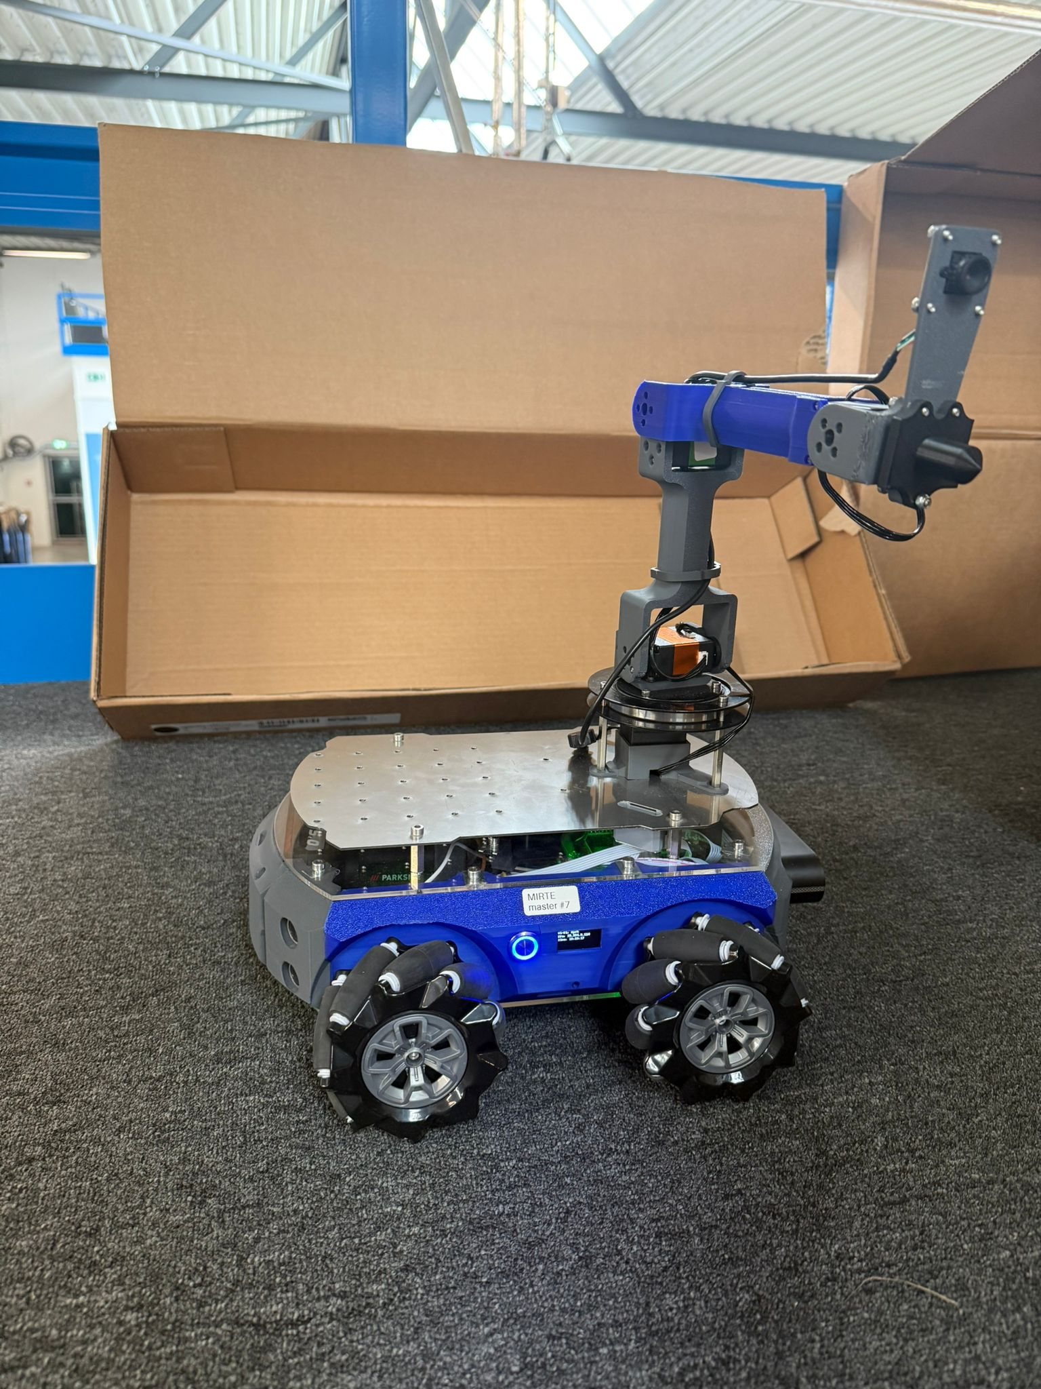
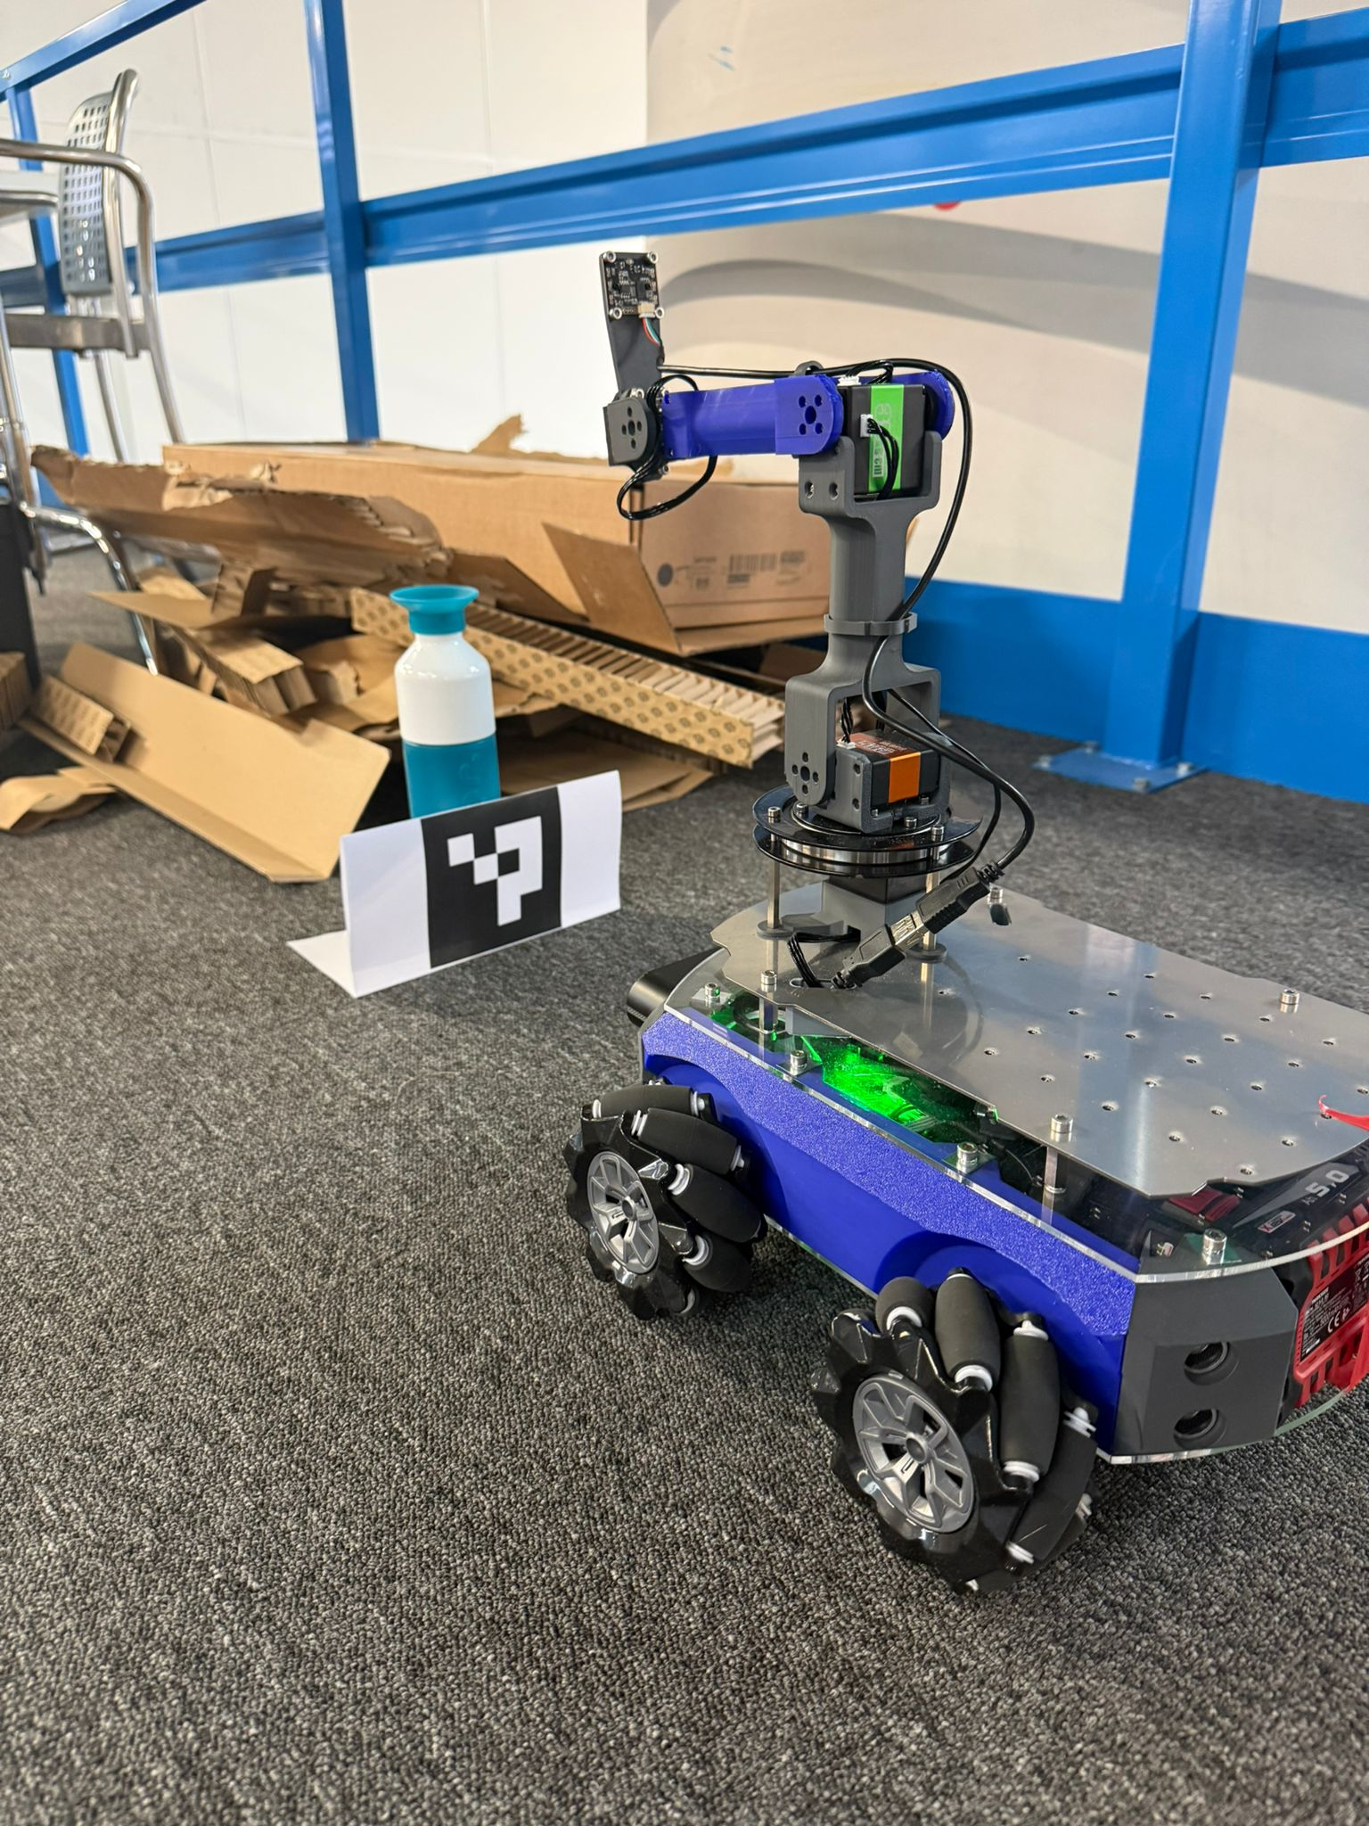
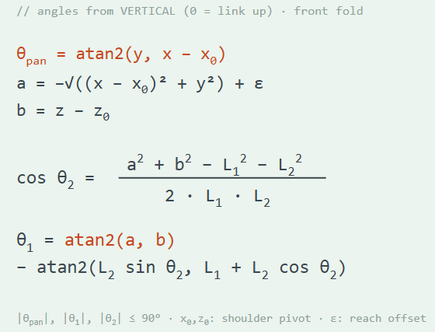
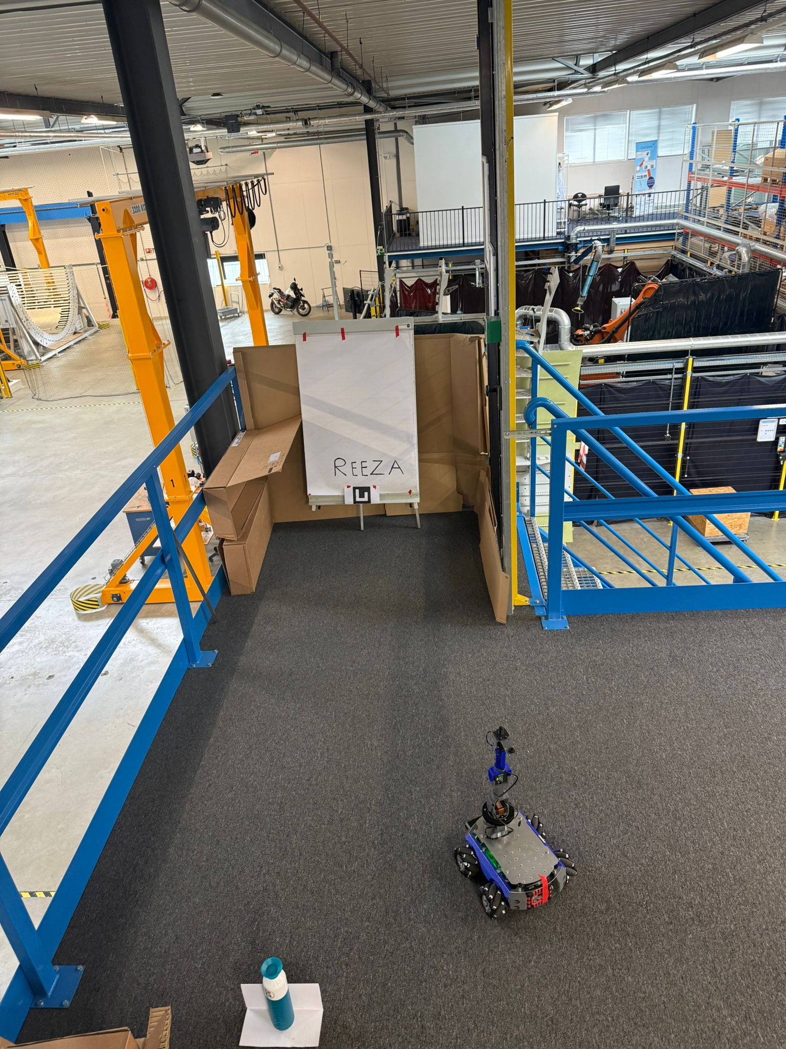
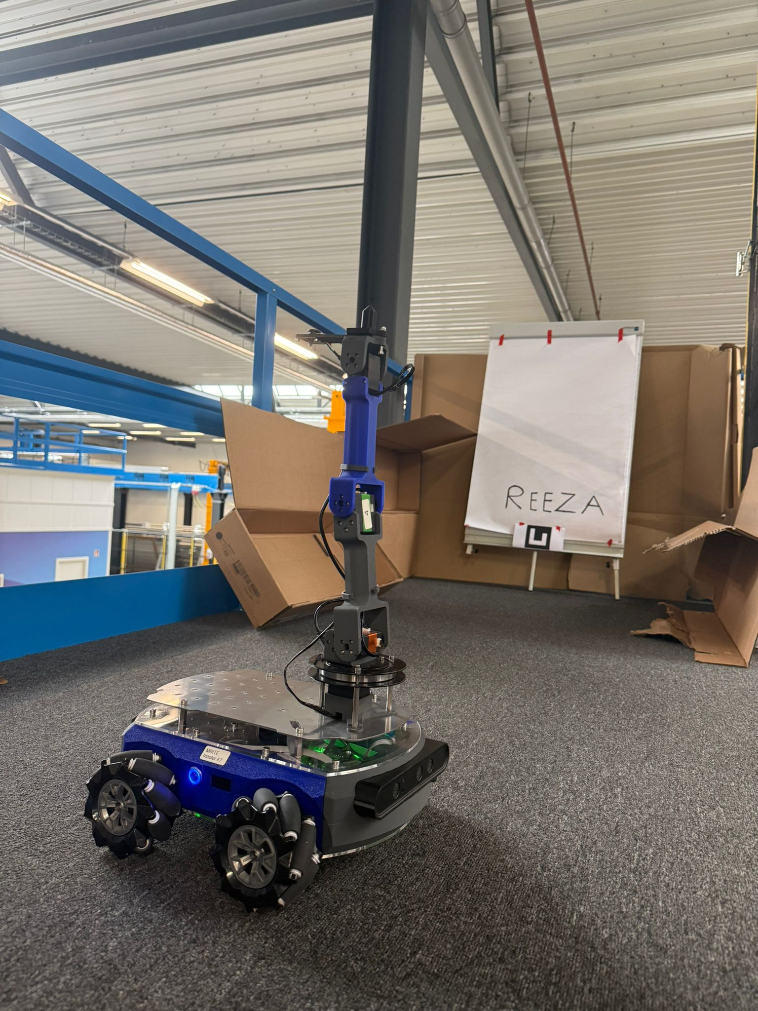
AE4ASM527 · Spatial AI in Industrial Automation · TU Delft ASM
Sand Drawing Robot
TUDelft
Autonomous pattern detection and reproduction using ROS2, computer vision, and robotic arm control on the Mirte Master 2 platform
ROBOTICS & AI
Group 1 · Mirte Master Robot 2 · SAM XL Symposium, June 11, 2026
01
Detect whiteboard
02
Read pattern
03
Navigate
04
Draw in sand
Roboflow detection
OCR via Roboflow
Drive to sandbox
Arm IK + probing
+ LiDAR approach
Workflow API
(Nav2 / fixed MVP)
single-stroke font
Problem Statement
System Architecture
Autonomous robots must perceive, interpret, and reproduce physical patterns without human intervention. The Mirte Master 2 must locate a whiteboard in an unknown environment, read text via OCR, navigate to a sandbox, and draw in sand — fully autonomously.
Five ROS2 nodes communicate via topics. Each self-activates based on the current phase.
The pipeline integrates four modules: mapping & localization, task planning, object detection & OCR, and gripper control — all coordinated via a central ROS2 state machine.
StateManager
mirte_statemachine
ROS2 Humble
Roboflow
OpenCV
LiDAR
/robot_state
2-link IK
Nav2
ArUco
State Machine
Object
Detection
(GoalGen)
Vision
Controller
(mirte_nav)
Text
Detection
(mirte_perc.)
Sand
Drawer
(mirte_draw)
StateManager orchestrates all phases.
RAISE
ARM
TRACK
WB
READ
PATT.
NAV
SBOX.
DRAW
PATT.
DONE
/target_angle
/wb_text
Robot in action
via /state_change · /robot_state every 0.5 s
/state_change
Mirte approaching the whiteboard
Inverse Kinematics — 2-link analytical
Shoulder
Elbow
// 2-link IK solver
/robot_state
data topic
/state_change
L₁=0.138m
L₂=0.143m
Robot
End eff.
sand surface
Pattern detection
OCR + bounding box output
Key Design Choices
Roboflow for detection & OCR
External ML inference for whiteboard detection and text OCR; handles variable lighting. Runs as a subprocess; the ROS node stages camera frames via atomic rename so inference never reads a half-written file.
Atomic frame write (.tmp → .jpg)
System overview photo
Prevents race conditions between camera publisher and OCR subprocess via os.replace().
Full setup: robot, whiteboard & sandbox
Sand output
Final drawn pattern
Analytical 2-link IK
Conclusion & future work
Deterministic closed-form solution: microsecond-level waypoint-to-joint-angle conversion, no iterative solver.
The Sand Drawing Robot demonstrates a complete perception-to-execution pipeline on a real mobile platform. Key achievements: robust whiteboard detection via Roboflow (camera) with LiDAR-based ranging/approach, OCR text extraction, and letter drawing via a custom single-stroke font with effort-based height probing.
Effort-based sand probing
Open item: NAVIGATE_TO_SANDBOX in active development. Fixed sandbox used as MVP fallback.
Arm descends in ~1 cm (0.01 m) z-steps; a joint-effort spike auto-calibrates the draw height per session. Disabled by default — a fixed draw height is used as fallback.
Single-stroke font (A–Z)
Limitations: Roboflow API adds latency. Drawing happens a few cm above the surface, bounded by the arm's vertical reach (wrist stays ~4 cm above ground; pen bridges the gap).
Custom normalized letterforms minimize pen-lift events and total arm travel distance.
AE4ASM527 · Sand Drawing Robot · Group 1 · TU Delft · June 2026
github.com/Wtoutenhoofd/Spatial-AI-group-1

